Slide 1

Lecture 8: JavaScript DOM
Open Source Web Software

Slide 2
Table of Contents
jQuery Basics
jQuery Effects
jQuery HTML/CSS
Practice
Summary and Discussions

Slide 3
jQuery basics
Part 1

Slide 4
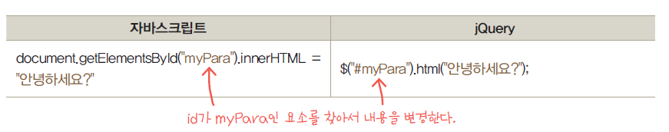
jQuery Basics
What is jQuery?
jQuery is a JavaScript Library
jQuery greatly simplifies JavaScript programming
jQuery is easy to learn
jQuery has plugins for almost any task out there

Slide 5
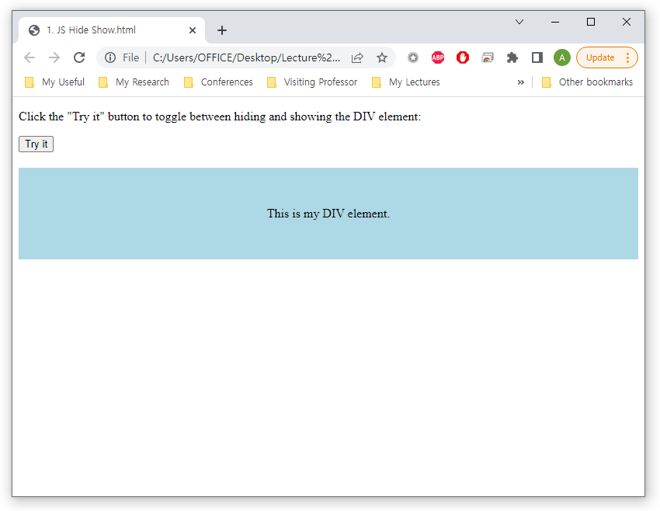
jQuery Basics
Why jQuery?
Quiz
Write a JavaScript code to toggle between hiding and showing the DIV element

Slide 6
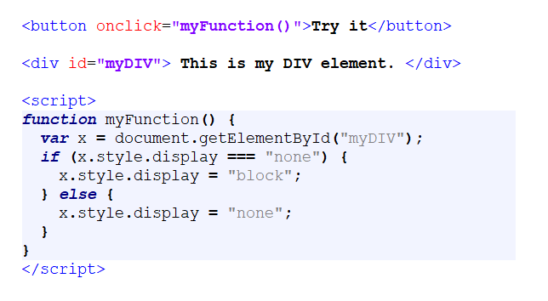
jQuery Basics
Why jQuery?
Quiz
Use display property to show and hide the div box

Slide 7
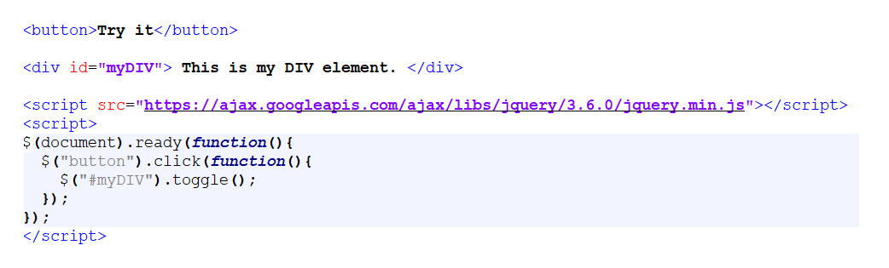
jQuery Basics
Why jQuery?
jQuery greatly simplifies JavaScript programming
Created show and hide effect using toggle() function of jQuery

Slide 8
jQuery Basics
Adding jQuery to your websites
Two ways
Download the jQuery library from jQuery.com
Include jQuery your HTML file
jQuery header
Syntax
<head>
<script src=
"https://ajax.googleapis.com/ajax/libs/jquery/3.6.0/jquery.min.js"></script>
</head>

Slide 9
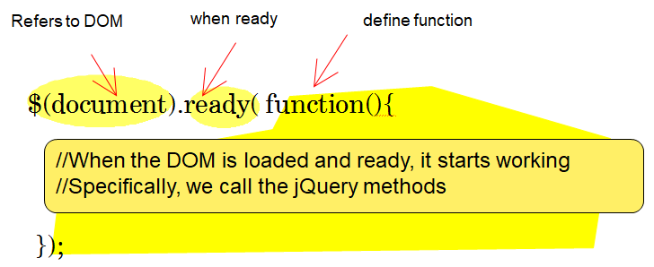
jQuery Basics
jQuery Syntax
It is good practice to wait for the document to be fully loaded and ready before working with it

Slide 10
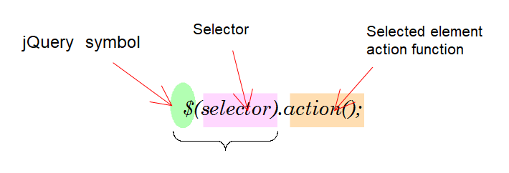
jQuery Basics
jQuery Syntax
Select a desired element by putting a selector in $ (...), and perform various actions on the selected element
$("p").hide() - hides all <p> elements
$(".test").hide() - hides all elements with class="test"

Slide 11
jQuery Basics
jQuery Selectors
jQuery selectors allow you to select and manipulate HTML element(s)
jQuery selectors are used to "find" (or select) HTML elements based on:
Name
Id
Classes
Types
Attributes
Values of attributes
Similar to CSS selectors
https://www.w3schools.com/jquery/trysel.asp

Slide 12
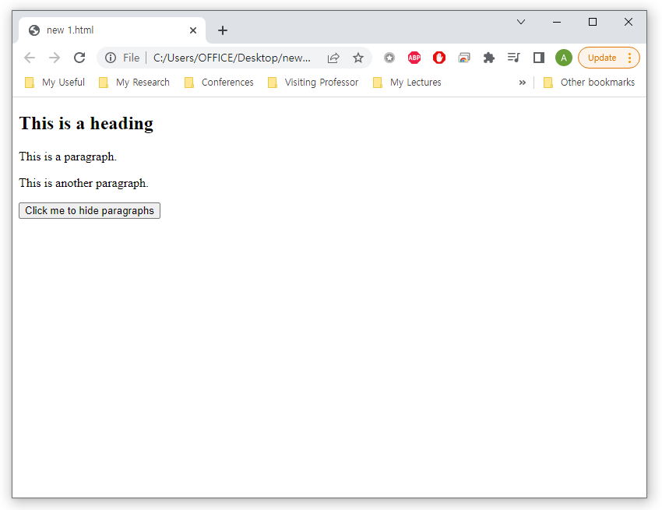
jQuery Basics
jQuery Selectors – The Element Selector
Selects elements based on the element name
Example: selecting <p> tag and perform hide() action
<script src="https://ajax.googleapis.com/ajax/libs/jquery/3.6.0/jquery.min.js"></script>
<script>
$(document).ready(function(){
$("button").click(function(){
$("p").hide();
});
});
</script>
</head>
<body>
<h2>This is a heading</h2>
<p>This is a paragraph.</p>
<p>This is another paragraph.</p>
<button>Click me to hide paragraphs</button>

Slide 13
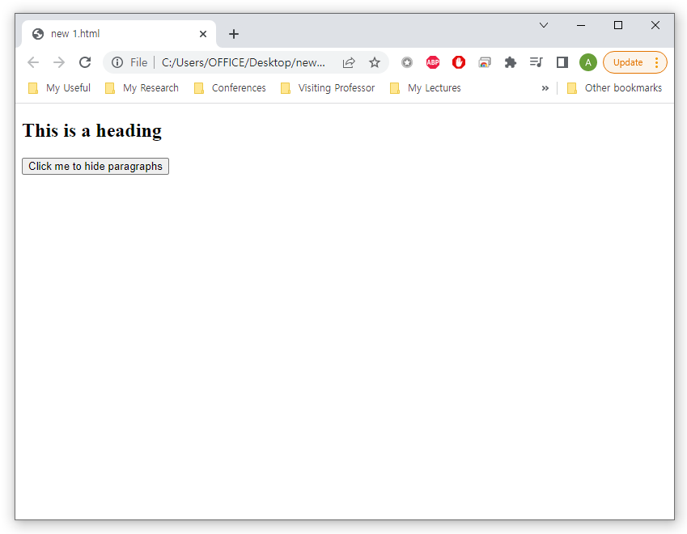
jQuery Basics
jQuery Selectors – The Element Selector
Selects elements based on the element name
Example: selecting <p> tag and perform hide() action
<script src="https://ajax.googleapis.com/ajax/libs/jquery/3.6.0/jquery.min.js"></script>
<script>
$(document).ready(function(){
$("button").click(function(){
$("p").hide();
});
});
</script>
</head>
<body>
<h2>This is a heading</h2>
<p>This is a paragraph.</p>
<p>This is another paragraph.</p>
<button>Click me to hide paragraphs</button>

Slide 14
jQuery Basics
jQuery Selectors
Other jQuery selectors
Selector | Example | Selects
* | $("*") | All elements
#id | $("#lastname") | The element with id="lastname"
.class | $(".intro") | All elements with class="intro"
.class,.class | $(".intro,.demo") | All elements with the class "intro" or "demo"
element | $("p") | All <p> elements
el1,el2,el3 | $("h1,div,p") | All <h1>, <div> and <p> elements
:first | $("p:first") | The first <p> element
:last | $("p:last") | The last <p> element
:even | $("tr:even") | All even <tr> elements
:odd | $("tr:odd") | All odd <tr> elements

Slide 15
jQuery Basics
jQuery Events
An event represents the precise moment when something happens
moving a mouse over an element
selecting a radio button
clicking on an element
Examples
$(selector).click(function)
$(selector).mouseover(function)
Mouse Events | Keyboard Events | Form Events | Document/Window Events
click | keypress | submit | load
dblclick | keydown | change | resize
mouseenter | keyup | focus | scroll
mouseleave |  | blur | unload

Slide 16
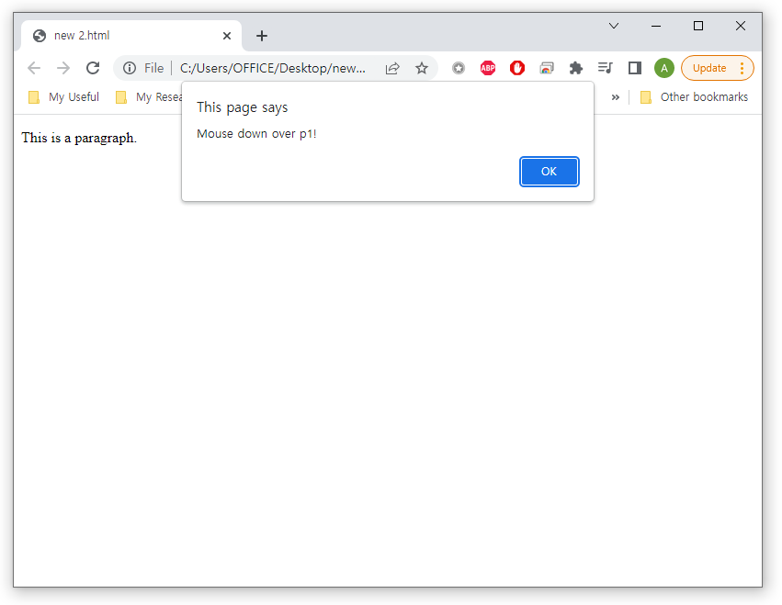
jQuery Basics
jQuery Events
Example of mousedown() event
<!DOCTYPE html>
<html>
<head>
<script src="https://ajax.googleapis.com/ajax/libs/jquery/3.6.0/jquery.min.js"></script>
<script>
$(document).ready(function(){
$("#p1").mousedown(function(){
alert("Mouse down over p1!");
});
});
</script>
</head>
<body>
<p id="p1">This is a paragraph.</p>
</body>
</html>

Slide 17
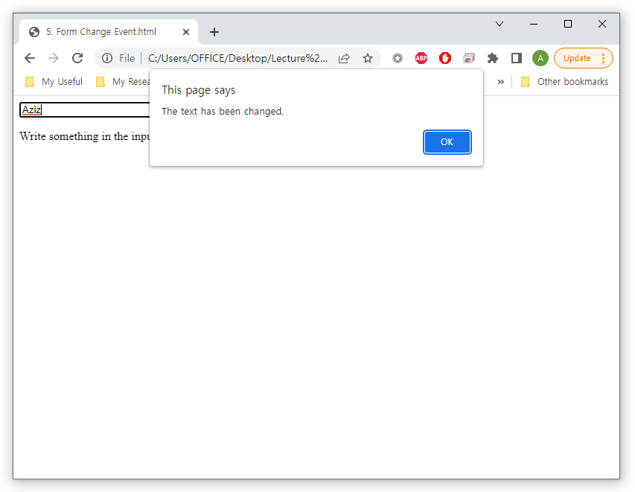
jQuery Basics
jQuery Events
Example of change() event
<!DOCTYPE html>
<html>
<head>
<script src="https://ajax.googleapis.com/ajax/libs/jquery/3.6.0/jquery.min.js"></script>
<script>
$(document).ready(function(){
$("input").change(function(){
alert("The text has been changed.");
});
});
</script>
</head>
<body>
<input type="text">
<p>Write something in the input field, and then press enter</p>
</body>
</html>

Slide 18
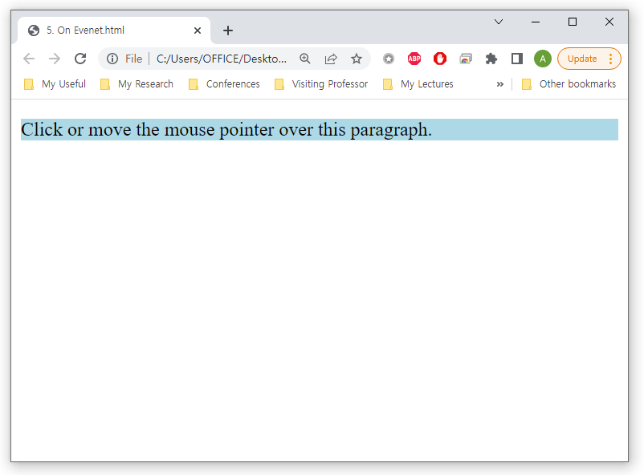
jQuery Basics
jQuery Events
The on() method attaches one or more event handlers
<script>
$(document).ready(function(){
$("p").on({
mouseenter: function(){
$(this).css("background-color", "lightgray");
},
mouseleave: function(){
$(this).css("background-color", "lightblue");
},
click: function(){
$(this).css("background-color", "yellow");
}
});
});
</script>
</head>
<body>
<p>Click or move the mouse pointer over this paragraph.</p>

Slide 19
jQuery Effects
Part 2

Slide 20
jQuery Effects
jQuery Effects
jQuery functions which visibly affect HTML elements
Effects
$(selector).hide() - Hide selected elements
$(selector).show() - Show selected elements
$(selector).toggle() - Toggle selected elements between hide and show
$(selector).slideDown() - Slide-down (show) selected elements
$(selector).slideUp() - Slide-up (hide) selected elements
$(selector).slideToggle() - Toggle slide-up and slide-down of selected elements
$(selector).fadeIn() - Fade in (show) selected elements
$(selector).fadeOut() - Fade out (hide) selected elements
$(selector).fadeTo() - Fade out selected elements to a given opacity
$(selector).animate() - Perform a custom animation (such as a width or height change) on selected elements

Slide 21
jQuery Effects
jQuery Hide/Show
Syntax
$(selector).hide(speed,callback);
$(selector).show(speed,callback);
Speed
Specifies the speed of the hiding/showing
Can take the following values
slow, fast, or milliseconds
Callback
A callback function is executed after the current effect is 100% finished

Slide 22
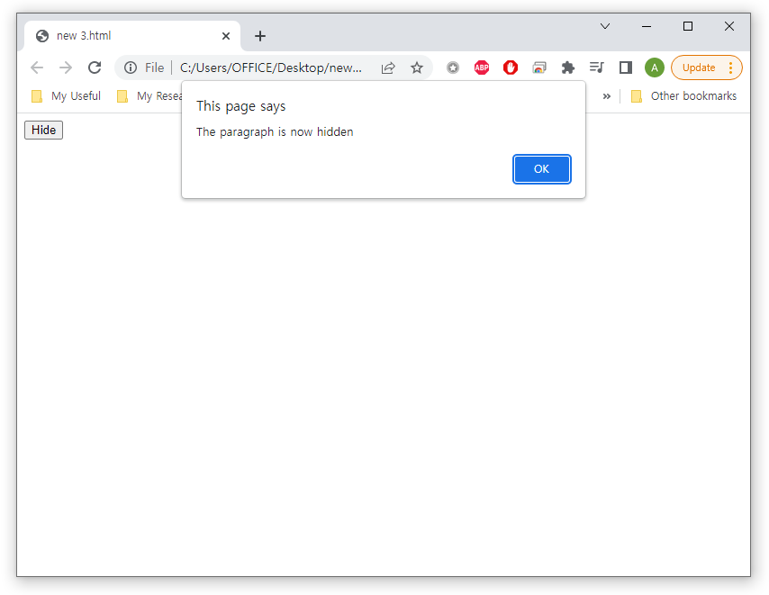
jQuery Effects
jQuery Hide/Show
Example
This is a callback function
<head>
<script src="https://ajax.googleapis.com/ajax/libs/jquery/3.6.0/jquery.min.js"></script>
<script>
$(document).ready(function(){
$("button").click(function(){
$("p").hide("slow", function(){
alert("The paragraph is now hidden");
});
});
});
</script>
</head>
<body>
<button>Hide</button>
<p>This is a paragraph with little content.</p>

Slide 23
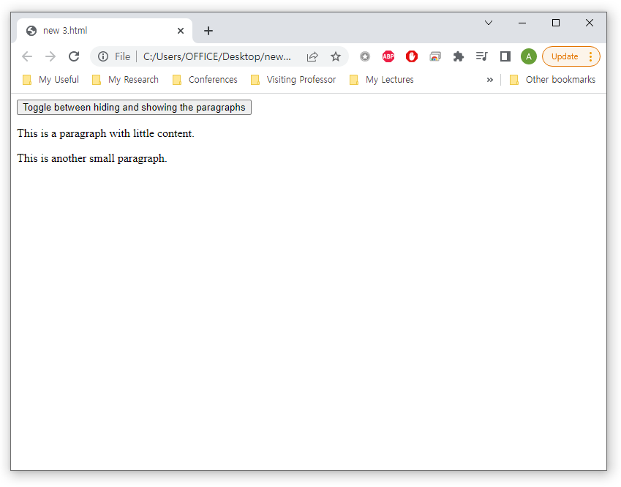
jQuery Effects
jQuery toggle() Method
Toggle between hiding and showing an element
<head>
<script src="https://ajax.googleapis.com/ajax/libs/jquery/3.6.0/jquery.min.js"></script>
<script>
$(document).ready(function(){
$("button").click(function(){
$("p").toggle();
});
});
</script>
</head>
<body>
<button>Toggle between hiding and showing the paragraphs</button>
<p>This is a paragraph with little content.</p>
<p>This is another small paragraph.</p>

Slide 24
jQuery Effects
jQuery Fading
With jQuery you can fade an element in and out of visibility.
jQuery has the following fade methods:
fadeIn()
fadeOut()
fadeToggle()
fadeTo()

Slide 25
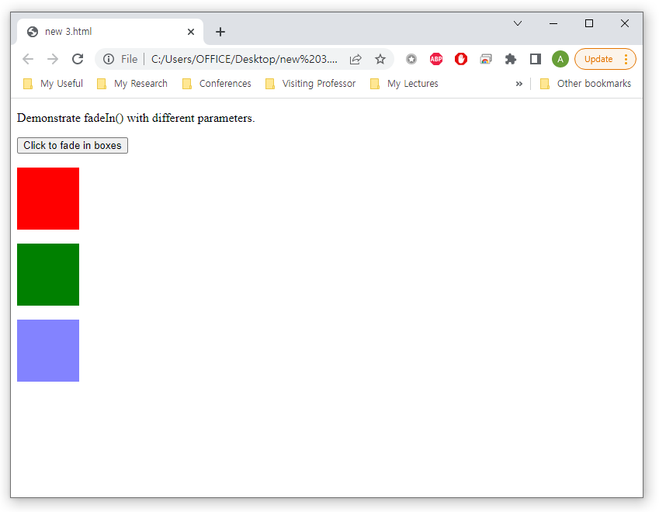
jQuery Effects
jQuery Fading – fadeIn() Method
Syntax
$(selector).fadeIn(speed,callback);
<script>
$(document).ready(function(){
$("button").click(function(){
$("#div1").fadeIn();
$("#div2").fadeIn("slow");
$("#div3").fadeIn(3000);
});
});
</script>
<body>
<p>Demonstrate fadeIn() with different parameters.</p>
<button>Click to fade in boxes</button><br><br>
<div id="div1" style="width:80px;height:80px;display:none;background-color:red;"></div><br>
<div id="div2" style="width:80px;height:80px;display:none;background-color:green;"></div><br>
<div id="div3" style="width:80px;height:80px;display:none;background-color:blue;"></div>

Slide 26
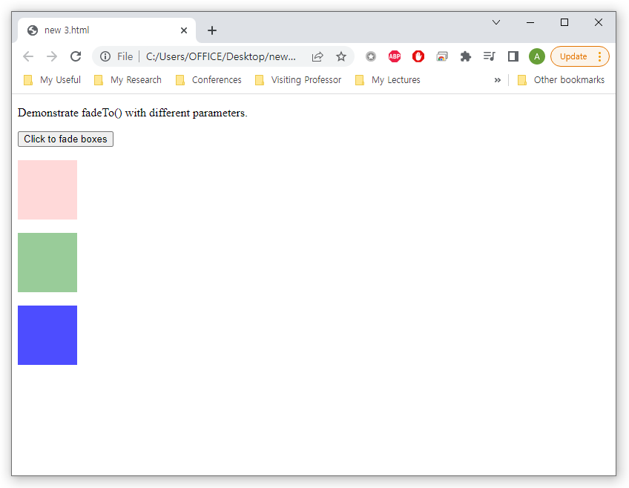
jQuery Effects
jQuery Fading – fadeTo() Method
Syntax
$(selector).fadeTo(speed,opacity,callback);
<script>
$(document).ready(function(){
$("button").click(function(){
$("#div1").fadeTo("slow", 0.15);
$("#div2").fadeTo("slow", 0.4);
$("#div3").fadeTo("slow", 0.7);
});
});
</script>
<body>
<p>Demonstrate fadeTo() with different parameters.</p>
<button>Click to fade boxes</button><br><br>
<div id="div1" style="width:80px;height:80px;background-color:red;"></div><br>
<div id="div2" style="width:80px;height:80px;background-color:green;"></div><br>
<div id="div3" style="width:80px;height:80px;background-color:blue;"></div>

Slide 27
jQuery Effects
jQuery Slide
With jQuery you can create a sliding effect on elements.
jQuery has the following slide methods:
slideDown()
slideUp()
slideToggle()

Slide 28
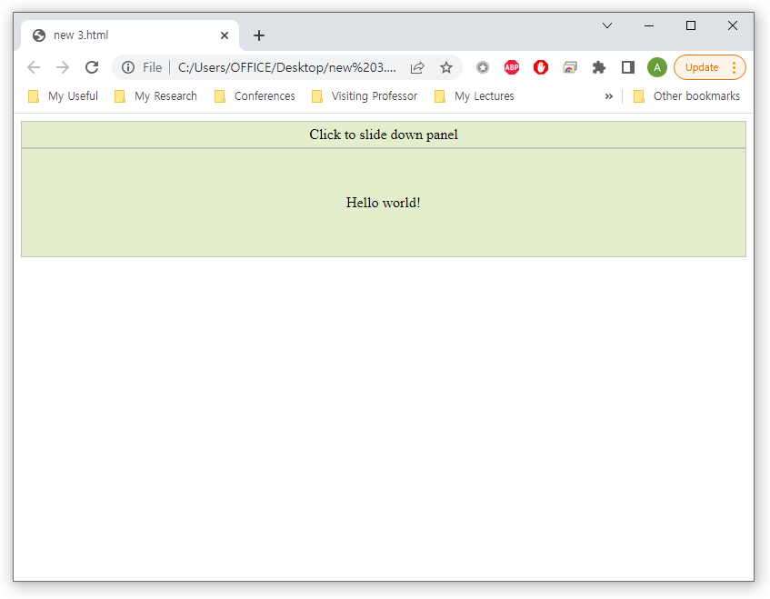
jQuery Effects
jQuery Slide – slideDown() Method
Syntax
$(selector).slideDown(speed,callback);
<script>
$(document).ready(function(){
$("#flip").click(function(){
$("#panel").slideDown("slow");
});
});
</script>
<style>
…
</style>
</head>
<body>
<div id="flip">Click to slide down panel</div>
<div id="panel">Hello world!</div>

Slide 29
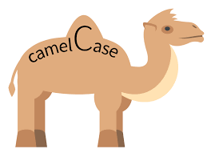
jQuery Effects
jQuery Animate – The animate() Method
Syntax
$(selector).animate({params},speed,callback);
The required params parameter defines the CSS properties to be animated
You can manipulate ALL CSS properties with the animate() method. HOWEVER!
All property names must be camel-cased when used with the animate() method: padding-left -> paddingLeft
Color animation is not included in the core jQuery library

Slide 30
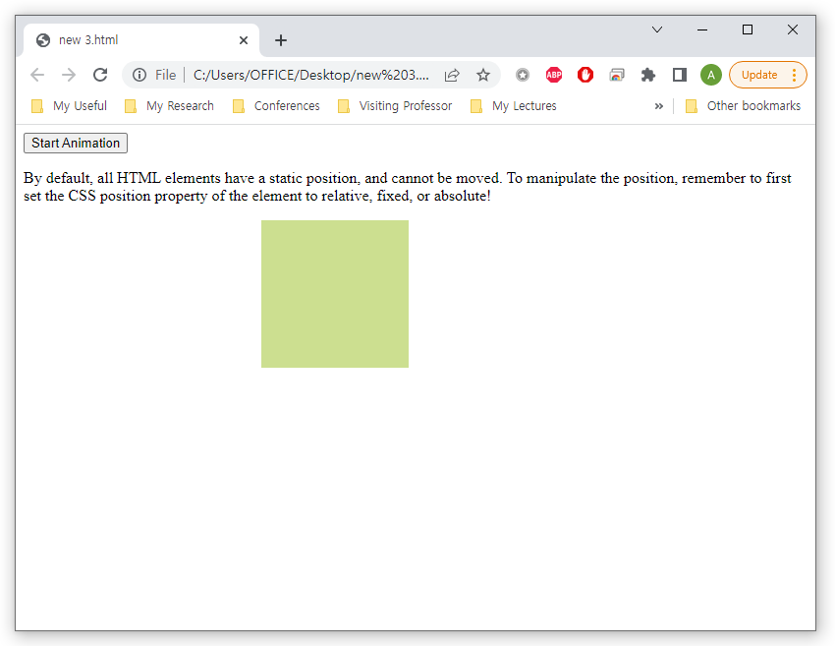
jQuery Effects
jQuery Animate – The animate() Method
Example
<script>
$(document).ready(function(){
$("button").click(function(){
$("div").animate({
left: '250px',
opacity: '0.5',
height: '150px',
width: '150px'
});
});
});
</script>
</head>
<body>
<button>Start Animation</button>
<div style="background:#98bf21;height:100px;width:100px;position:absolute;"></div>

Slide 31
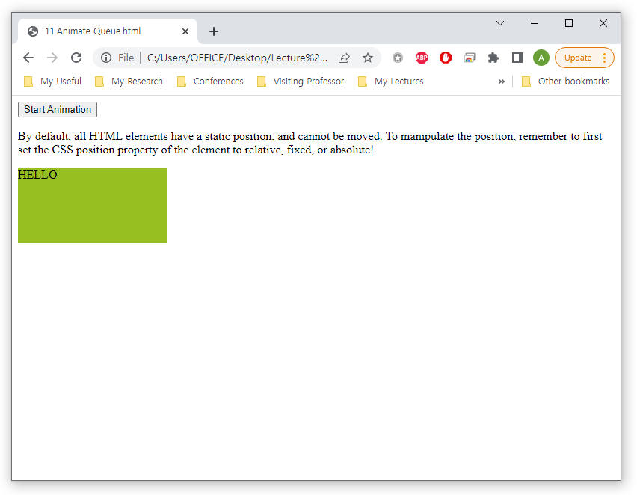
jQuery Effects
jQuery Animate
jQuery animate() - Uses Queue Functionality
<script src="https://ajax.googleapis.com/ajax/libs/jquery/3.6.0/jquery.min.js"></script>
<script>
$(document).ready(function(){
$("button").click(function(){
var div = $("div");
div.animate({left: '100px'}, "slow");
div.animate({fontSize: '3em'}, "slow");
});
});
</script>
</head>
<body>
<button>Start Animation</button>
<div style="background:#98bf21;height:100px;width:200px;position:absolute;">HELLO</div>
</body>
</html>

Slide 32
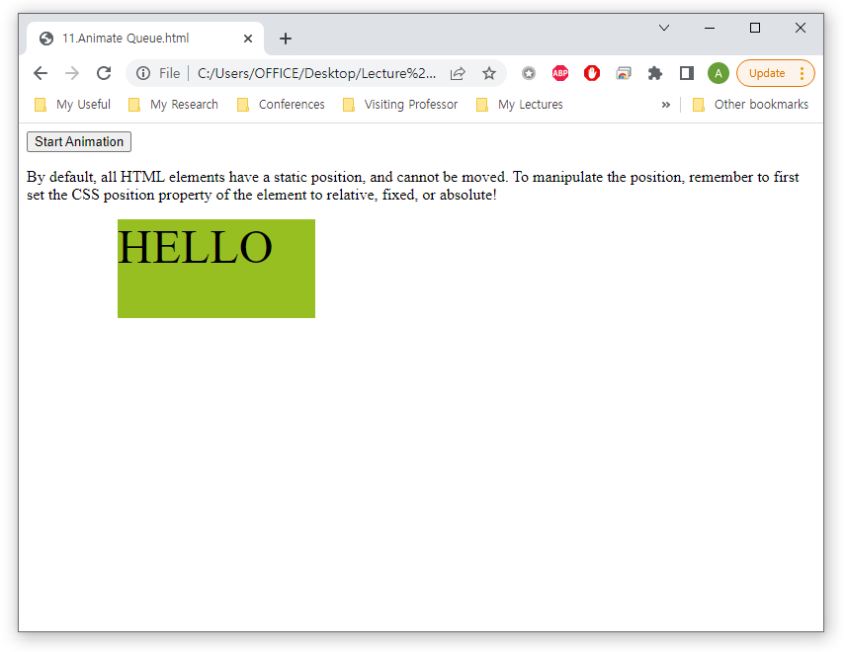
jQuery Effects
jQuery Animate
jQuery animate() - Uses Queue Functionality
<script src="https://ajax.googleapis.com/ajax/libs/jquery/3.6.0/jquery.min.js"></script>
<script>
$(document).ready(function(){
$("button").click(function(){
var div = $("div");
div.animate({left: '100px'}, "slow");
div.animate({fontSize: '3em'}, "slow");
});
});
</script>
</head>
<body>
<button>Start Animation</button>
<div style="background:#98bf21;height:100px;width:200px;position:absolute;">HELLO</div>
</body>
</html>

Slide 33
jQuery HTML/CSS
Part 3

Slide 34
jQuery HTML/CSS
jQuery Get
jQuery DOM manipulation
Three simple, but useful, jQuery methods for DOM manipulation are
text() - Sets or returns the text content of selected elements
html() - Sets or returns the content of selected elements (including HTML markup)
val() - Sets or returns the value of form fields
attr() – Sets and returns attribute values

Slide 35
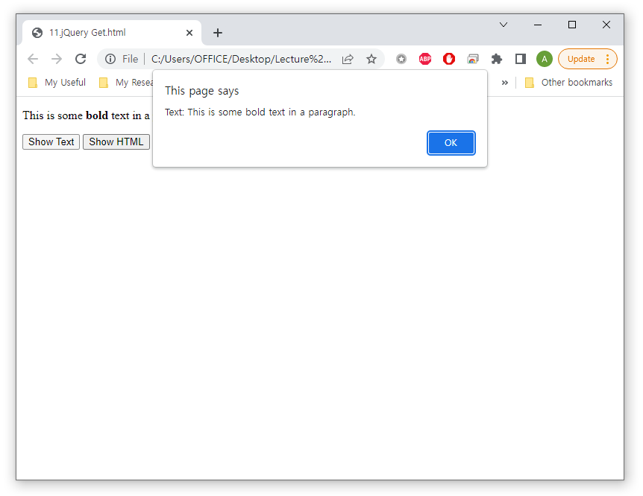
jQuery HTML/CSS
jQuery Get
Example of text() and html()
<script src="https://ajax.googleapis.com/ajax/libs/jquery/3.6.0/jquery.min.js"></script>
<script>
$(document).ready(function(){
$("#btn1").click(function(){
alert("Text: " + $("#test").text());
});
$("#btn2").click(function(){
alert("HTML: " + $("#test").html());
});
});
</script>
<p id="test">This is some <b>bold</b> text in a paragraph.</p>
<button id="btn1">Show Text</button>
<button id="btn2">Show HTML</button>
</body>
</html>

Slide 36
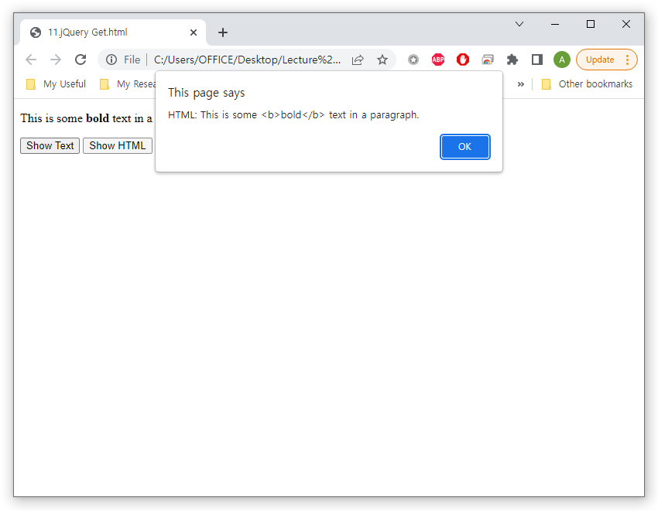
jQuery HTML/CSS
jQuery Get
Example of text() and html()
<script src="https://ajax.googleapis.com/ajax/libs/jquery/3.6.0/jquery.min.js"></script>
<script>
$(document).ready(function(){
$("#btn1").click(function(){
alert("Text: " + $("#test").text());
});
$("#btn2").click(function(){
alert("HTML: " + $("#test").html());
});
});
</script>
<p id="test">This is some <b>bold</b> text in a paragraph.</p>
<button id="btn1">Show Text</button>
<button id="btn2">Show HTML</button>
</body>
</html>

Slide 37
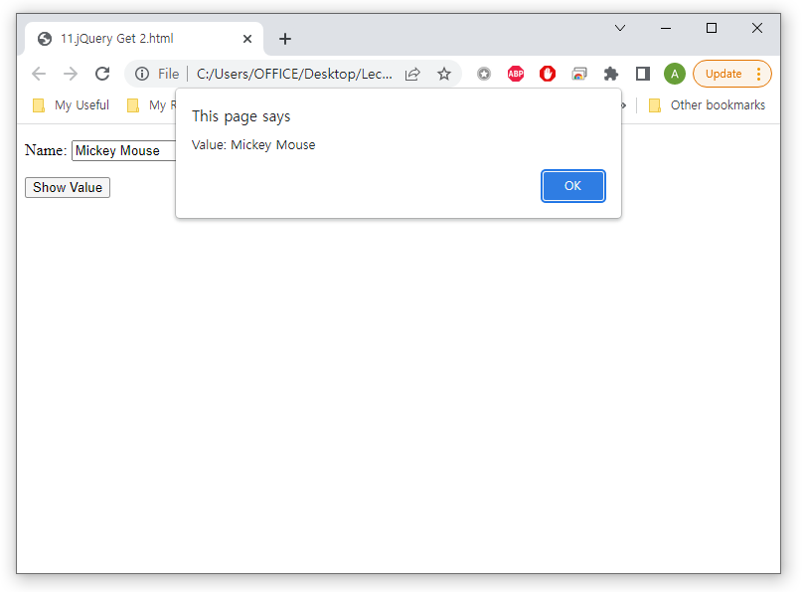
jQuery HTML/CSS
jQuery Get
Example of val()
<!DOCTYPE html>
<html>
<head>
<script src="https://ajax.googleapis.com/ajax/libs/jquery/3.6.0/jquery.min.js"></script>
<script>
$(document).ready(function(){
$("button").click(function(){
alert("Value: " + $("#test").val());
});
});
</script>
</head>
<body>
<p>Name: <input type="text" id="test" value="Mickey Mouse"></p>
<button>Show Value</button>
</body>
</html>

Slide 38
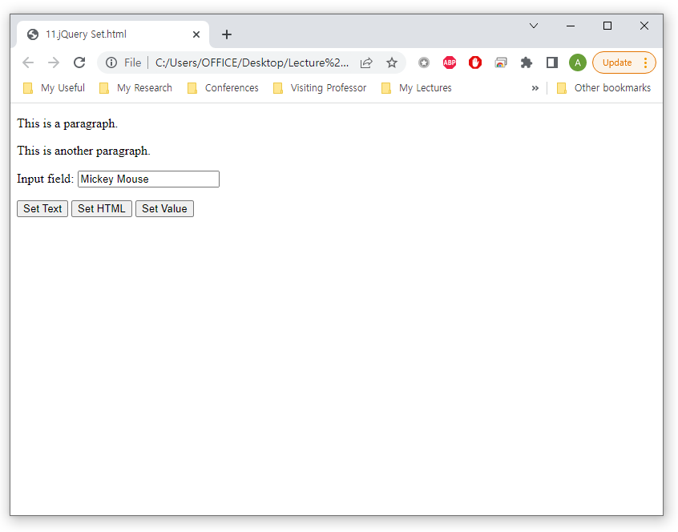
jQuery HTML/CSS
jQuery Set
Use the same three methods to set content
text(), html(), val()
<script>
$(document).ready(function(){
$("#btn1").click(function(){
$("#test1").text("Hello world!");
});
$("#btn2").click(function(){
$("#test2").html("<b>Hello world!</b>");
});
$("#btn3").click(function(){
$("#test3").val("Dolly Duck");
});
});
</script>
<p id="test1">This is a paragraph.</p>
<p id="test2">This is another paragraph.</p>
<p>Input field: <input type="text" id="test3" value="Mickey Mouse"></p>

Slide 39
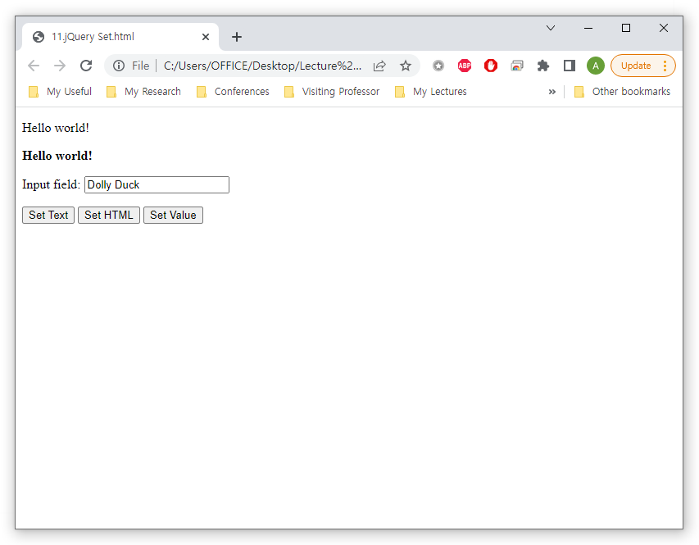
jQuery HTML/CSS
jQuery Set
Use the same three methods to set content
text(), html(), val()
<script>
$(document).ready(function(){
$("#btn1").click(function(){
$("#test1").text("Hello world!");
});
$("#btn2").click(function(){
$("#test2").html("<b>Hello world!</b>");
});
$("#btn3").click(function(){
$("#test3").val("Dolly Duck");
});
});
</script>
<p id="test1">This is a paragraph.</p>
<p id="test2">This is another paragraph.</p>
<p>Input field: <input type="text" id="test3" value="Mickey Mouse"></p>

Slide 40
jQuery HTML/CSS
jQuery Add
With jQuery, it is easy to add new elements/content.
We will look at four jQuery methods that are used to add new content:
append() - Inserts content at the end of the selected elements
prepend() - Inserts content at the beginning of the selected elements
after() - Inserts content after the selected elements
before() - Inserts content before the selected elements
Difference between these elements read here
https://stackoverflow.com/questions/14846506/append-prepend-after-and-before

Slide 41
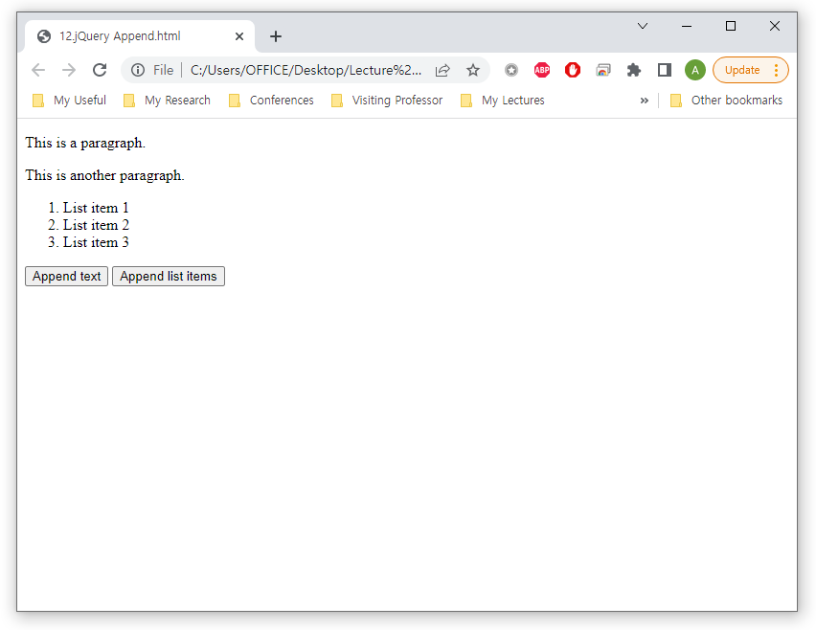
jQuery HTML/CSS
jQuery Add
Example of append() method
<script>
$(document).ready(function(){
$("#btn1").click(function(){
$("p").append(" <b>Appended text</b>.");
});
$("#btn2").click(function(){
$("ol").append("<li>Appended item</li>");
});
});
</script>
<p>This is a paragraph.</p>
<p>This is another paragraph.</p>
<ol>
<li>List item 1</li>
<li>List item 2</li>
<li>List item 3</li>
</ol>

Slide 42
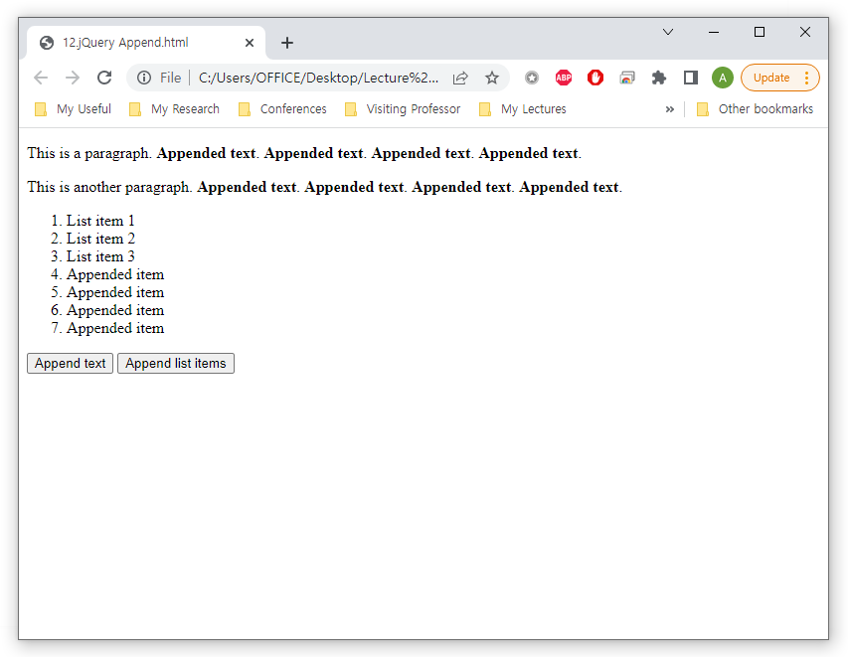
jQuery HTML/CSS
jQuery Add
Example of append() method
<script>
$(document).ready(function(){
$("#btn1").click(function(){
$("p").append(" <b>Appended text</b>.");
});
$("#btn2").click(function(){
$("ol").append("<li>Appended item</li>");
});
});
</script>
<p>This is a paragraph.</p>
<p>This is another paragraph.</p>
<ol>
<li>List item 1</li>
<li>List item 2</li>
<li>List item 3</li>
</ol>

Slide 43
jQuery HTML/CSS
jQuery Remove
With jQuery, it is easy to remove existing HTML elements
To remove elements and content, there are mainly two jQuery methods:
remove() - Removes the selected element (and its child elements)
empty() - Removes the child elements from the selected element

Slide 44
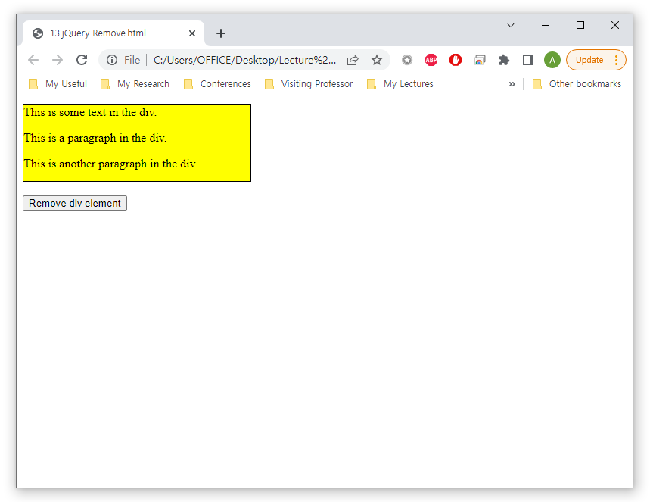
jQuery HTML/CSS
jQuery Remove
Example of remove()
<script>
$(document).ready(function(){
$("button").click(function(){
$("#div1").remove();
});
});
</script>
</head>
<body>
<div id="div1" style="height:100px;width:300px;border:1px solid black;background-color:yellow;">
This is some text in the div.
<p>This is a paragraph in the div.</p>
<p>This is another paragraph in the div.</p>
</div>
<button>Remove div element</button>

Slide 45
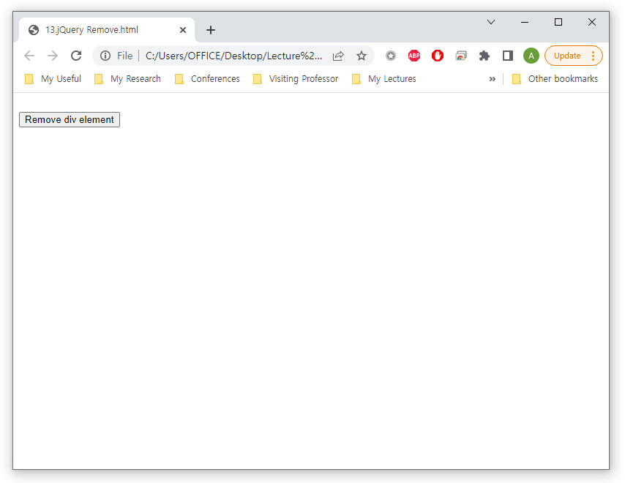
jQuery HTML/CSS
jQuery Remove
Example of remove()
<script>
$(document).ready(function(){
$("button").click(function(){
$("#div1").remove();
});
});
</script>
</head>
<body>
<div id="div1" style="height:100px;width:300px;border:1px solid black;background-color:yellow;">
This is some text in the div.
<p>This is a paragraph in the div.</p>
<p>This is another paragraph in the div.</p>
</div>
<button>Remove div element</button>

Slide 46
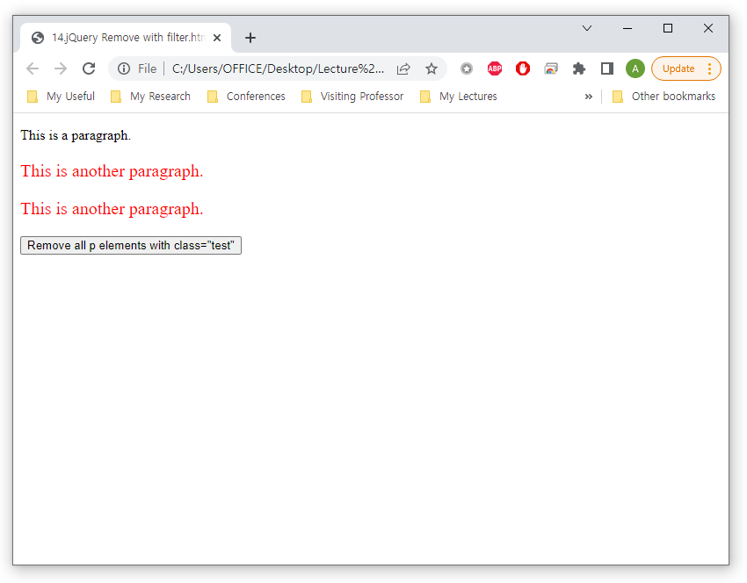
jQuery HTML/CSS
jQuery Remove
The jQuery remove() method also accepts one parameter, which allows you to filter the elements to be removed
<script>
$(document).ready(function(){
$("button").click(function(){
$("p").remove(".test");
});
});
</script>
</style>
<p>This is a paragraph.</p>
<p class="test">This is another paragraph.</p>
<p class="test">This is another paragraph.</p>
<button>Remove all p elements with class="test"</button>

Slide 47
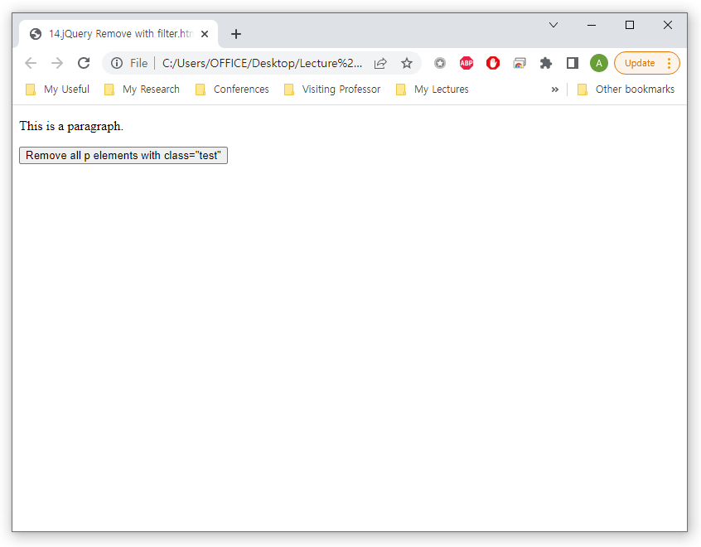
jQuery HTML/CSS
jQuery Remove
The jQuery remove() method also accepts one parameter, which allows you to filter the elements to be removed
<script>
$(document).ready(function(){
$("button").click(function(){
$("p").remove(".test");
});
});
</script>
</style>
<p>This is a paragraph.</p>
<p class="test">This is another paragraph.</p>
<p class="test">This is another paragraph.</p>
<button>Remove all p elements with class="test"</button>

Slide 48
jQuery HTML/CSS
jQuery CSS
The css() method sets or returns one or more style properties for the selected elements
Get
css(“propertyname”);
Ex: $("p").css("background-color");
Set
css(“propertyname”,”value");
Ex: $("p").css("background-color", "yellow");
Set multiple properties
css({"propertyname":"value","propertyname":"value",...});
Ex: $("p").css({"background-color": "yellow", "font-size": "200%"});

Slide 49
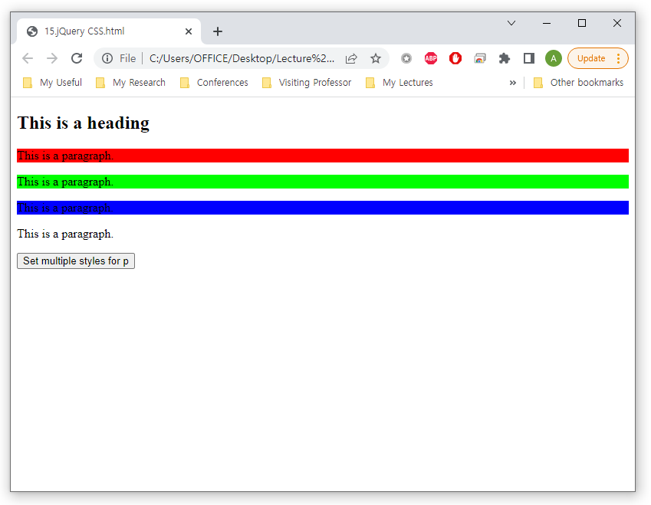
jQuery HTML/CSS
jQuery CSS
Example
<script>
$(document).ready(function(){
$("button").click(function(){
$("p").css({"background-color": "yellow", "font-size": "200%"});
});
});
</script>
</head>
<body>
<h2>This is a heading</h2>
<p style="background-color:#ff0000">This is a paragraph.</p>
<p style="background-color:#00ff00">This is a paragraph.</p>
<p style="background-color:#0000ff">This is a paragraph.</p>
<p>This is a paragraph.</p>
<button>Set multiple styles for p</button>

Slide 50
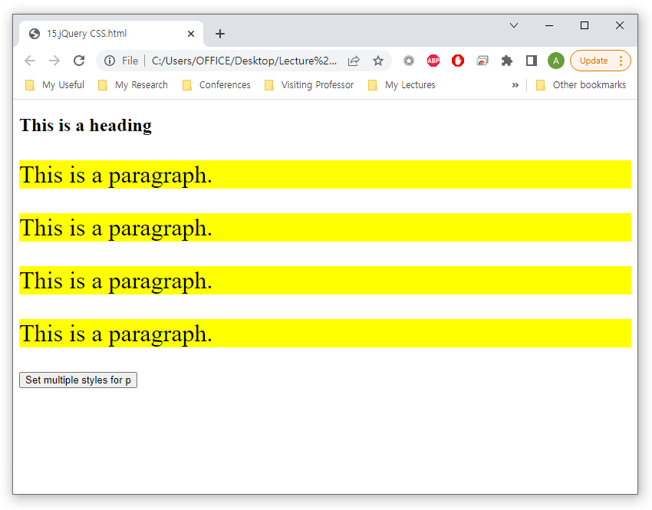
jQuery HTML/CSS
jQuery CSS
Example
<script>
$(document).ready(function(){
$("button").click(function(){
$("p").css({"background-color": "yellow", "font-size": "200%"});
});
});
</script>
</head>
<body>
<h2>This is a heading</h2>
<p style="background-color:#ff0000">This is a paragraph.</p>
<p style="background-color:#00ff00">This is a paragraph.</p>
<p style="background-color:#0000ff">This is a paragraph.</p>
<p>This is a paragraph.</p>
<button>Set multiple styles for p</button>

Slide 51
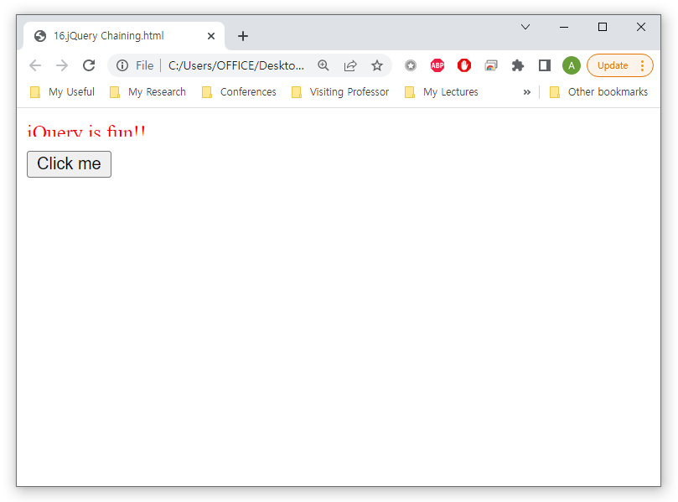
jQuery HTML/CSS
jQuery Chaining
Run multiple jQuery commands, one after the other, on the same element(s)
<!DOCTYPE html>
<html>
<head>
<script src="https://ajax.googleapis.com/ajax/libs/jquery/3.6.0/jquery.min.js"></script>
<script>
$(document).ready(function(){
$("button").click(function(){
$("#p1").css("color", "red").slideUp(2000).slideDown(2000);
});
});
</script>
</head>
<body>
<p id="p1">jQuery is fun!!</p>
<button>Click me</button>

Slide 52
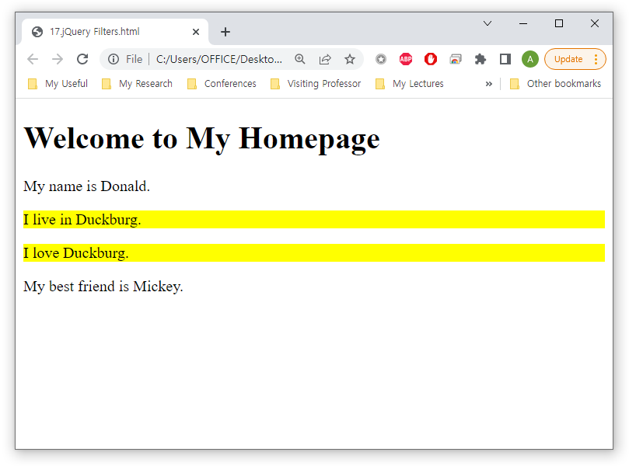
jQuery HTML/CSS
jQuery
The filter() method lets you specify a condition
<!DOCTYPE html>
<html>
<head>
<script src="https://ajax.googleapis.com/ajax/libs/jquery/3.6.0/jquery.min.js"></script>
<script>
$(document).ready(function(){
$("p").filter(".intro").css("background-color", "yellow");
});
</script>
</head>
<body>
<h1>Welcome to My Homepage</h1>
<p>My name is Donald.</p>
<p class="intro">I live in Duckburg.</p>
<p class="intro">I love Duckburg.</p>
<p>My best friend is Mickey.</p>

Slide 53
Summary and Discussions
jQuery Basics
jQuery Effects
jQuery HTML/CSS
Practice

Slide 54
See you next time!
Questions?

